Slide 1
Machine Learning Classification

Slide 2
Classification
Unlike regression where you predict a continuous number, you use classification to predict a category
Logistic Regression
K-Nearest Neighbors (K-NN)
Support Vector Machine (SVM)
Kernel SVM
Naive Bayes
Decision Tree Classification
Random Forest Classification

Slide 3
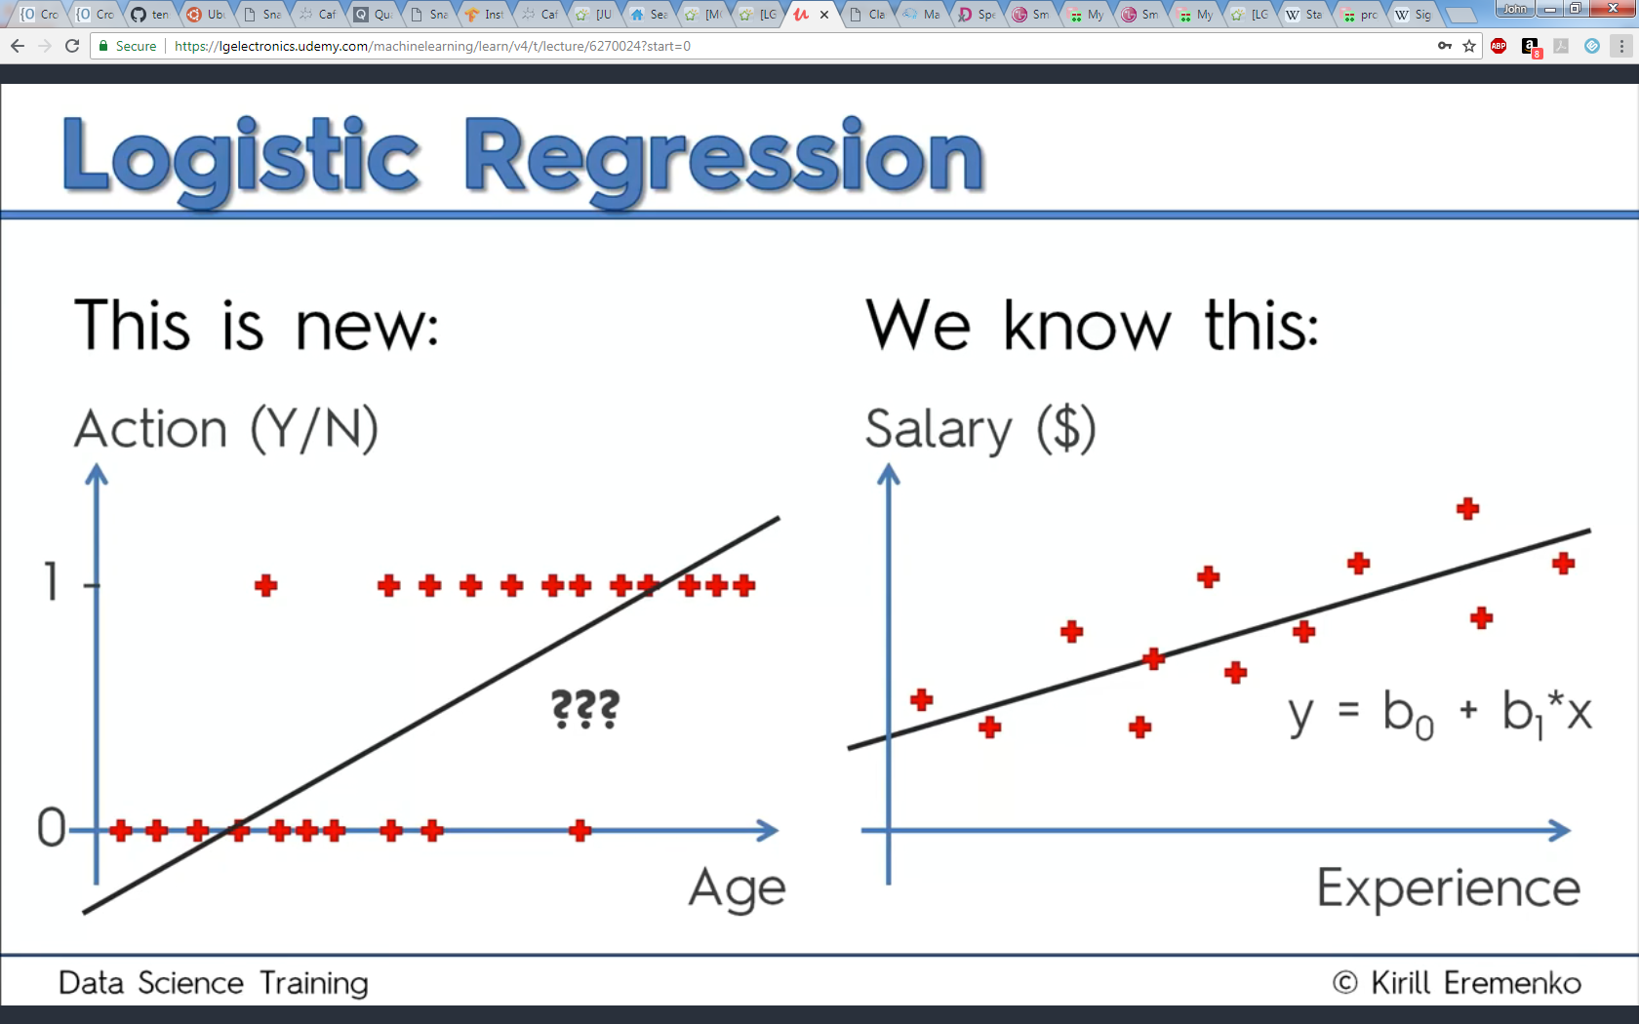
Logistic Regression
Linear regression does not fit ‘categorical’ data well

Slide 4
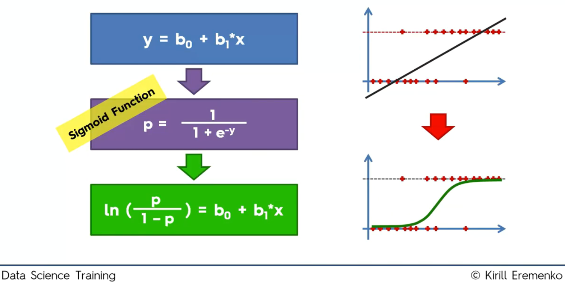
Logistic Regression
Logical regression, sigmoid function, fits better

Slide 5
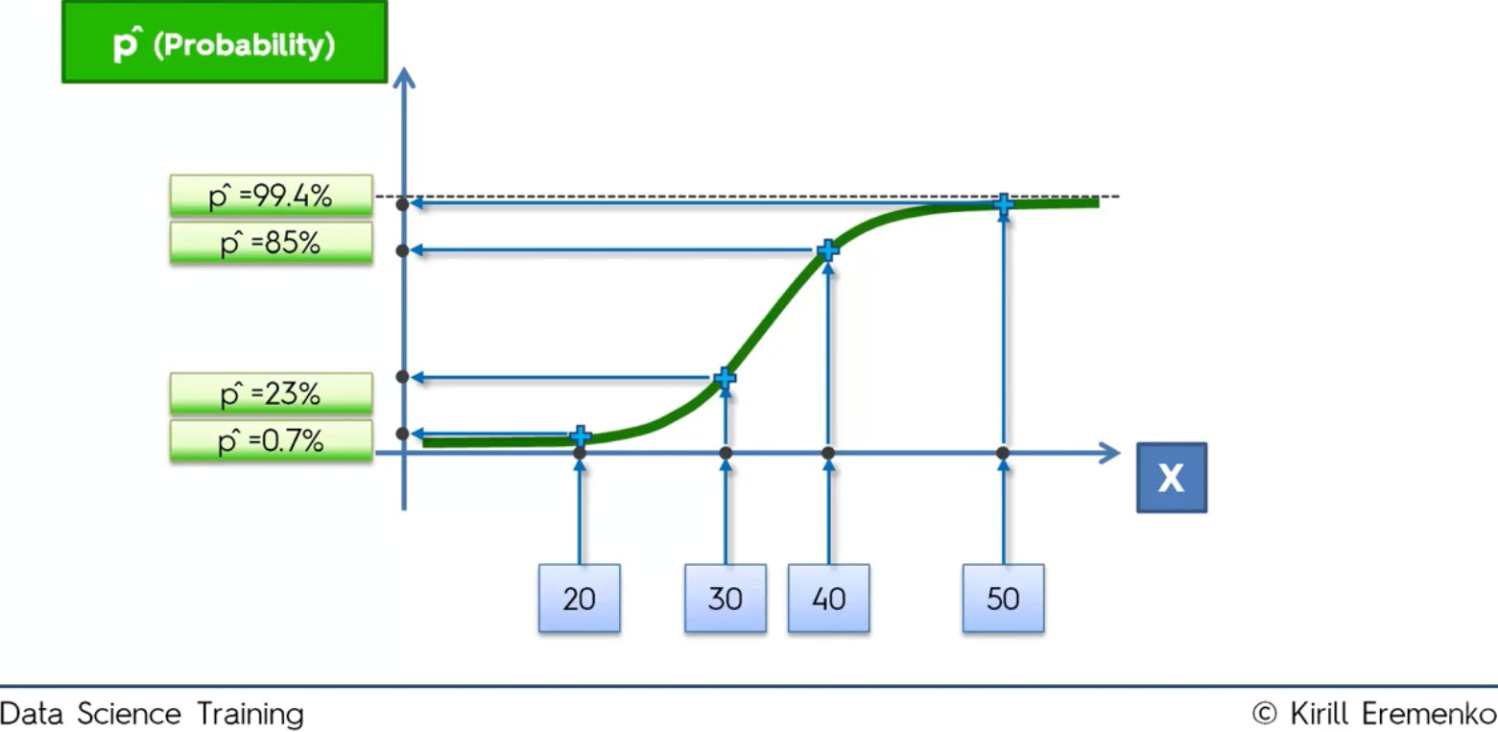
Logistic Regression
Sigmoid curve helps predict with probability at X

Slide 6
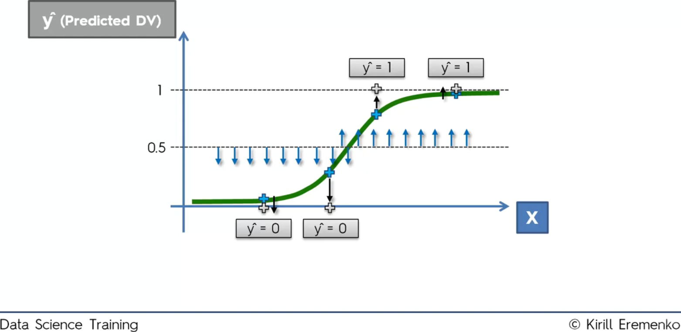
Logistic Regression
Make categorical prediction based on probability

Slide 7
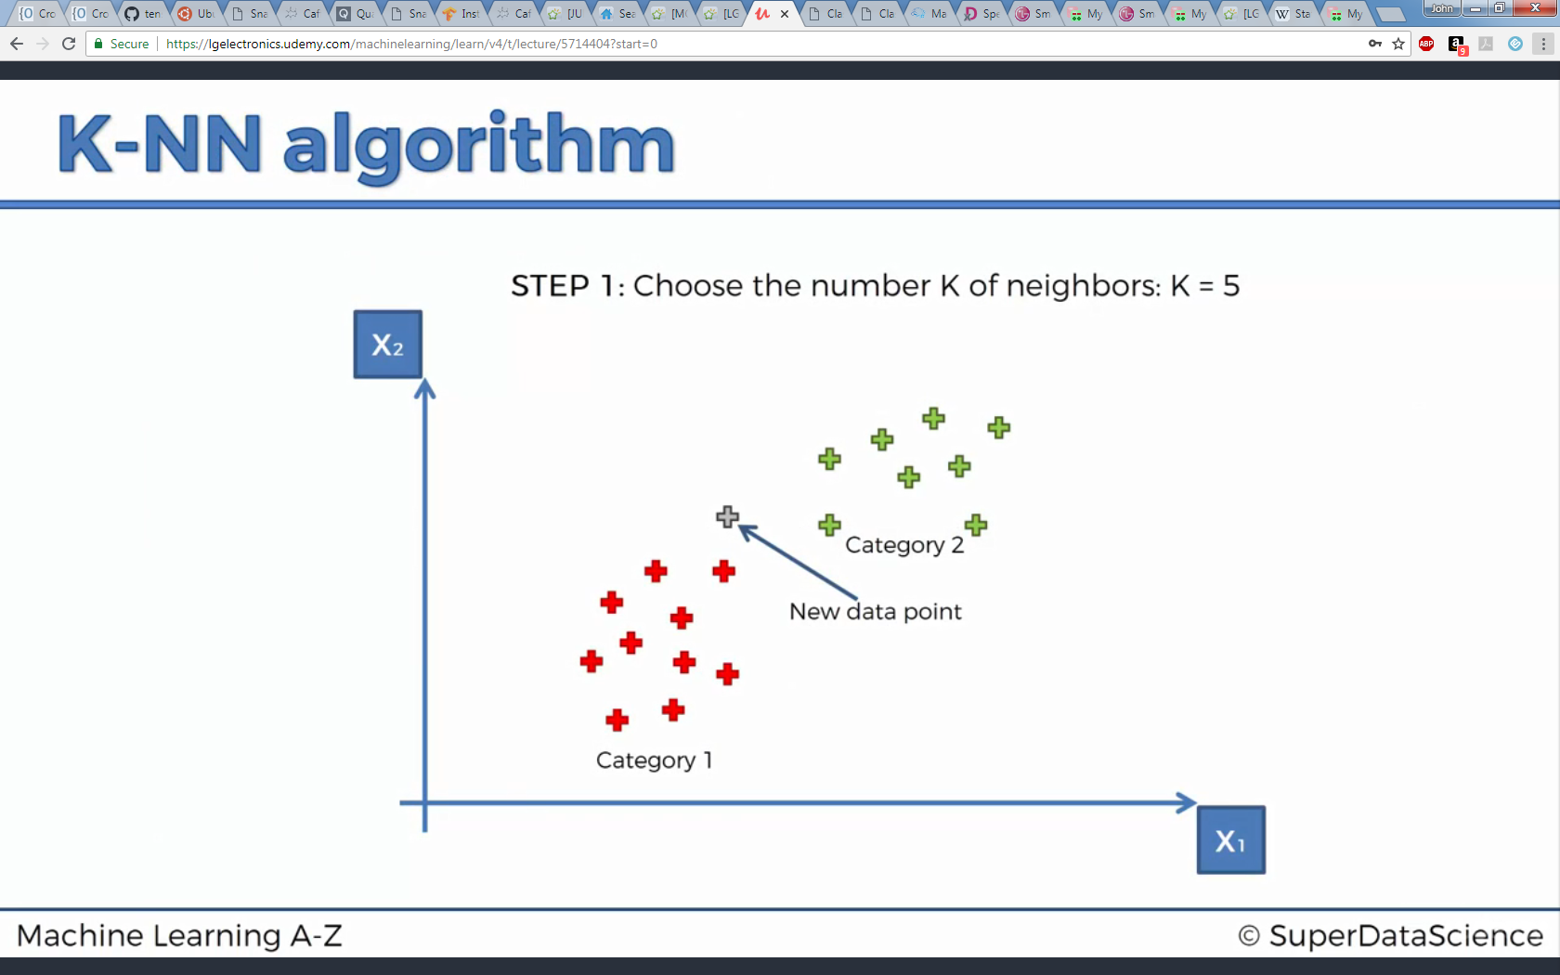
K-Nearest Neighbors (K-NN)

Slide 8
K-Nearest Neighbors (K-NN)
Step 1 : Choose the number K of neighbors
Step 2 : Take the K nearest neighbors of the new data point, according to the Euclidean distance
Step 3 : Among these K neighbors, count the number of data points in each category
Step 4 : Assign the new data point to the category where you counted the most neighbors

Slide 9
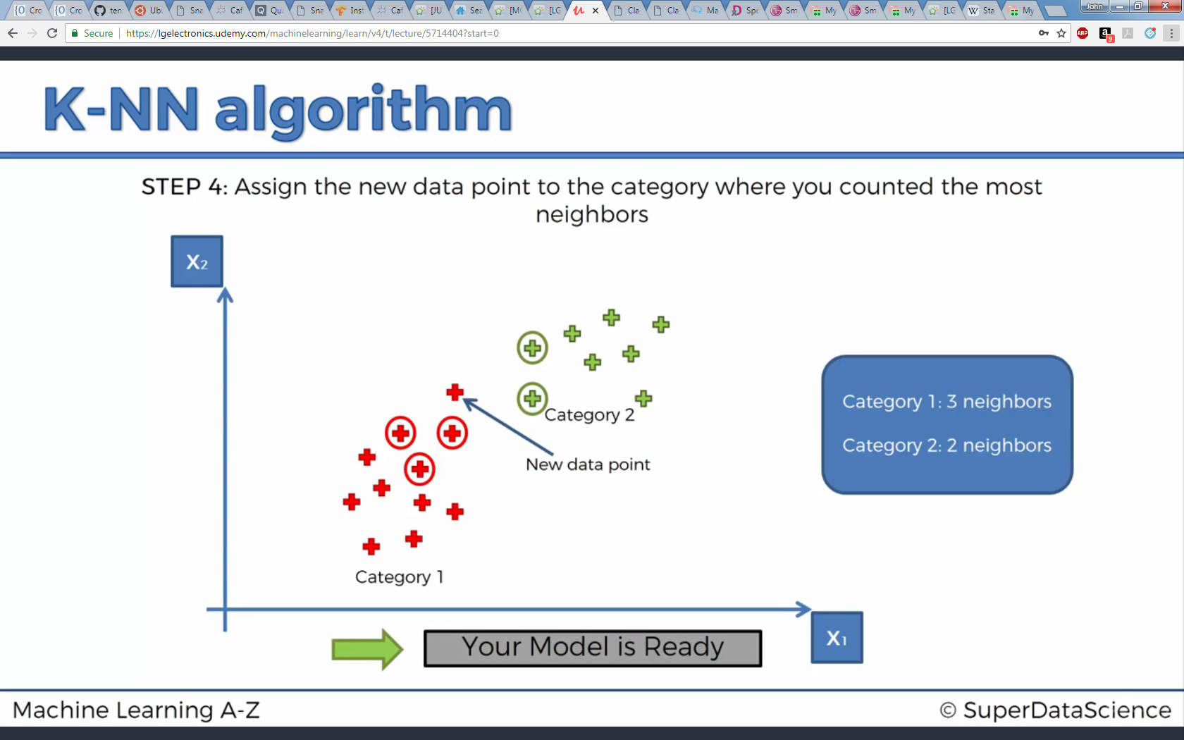
K-Nearest Neighbors (K-NN)

Slide 11
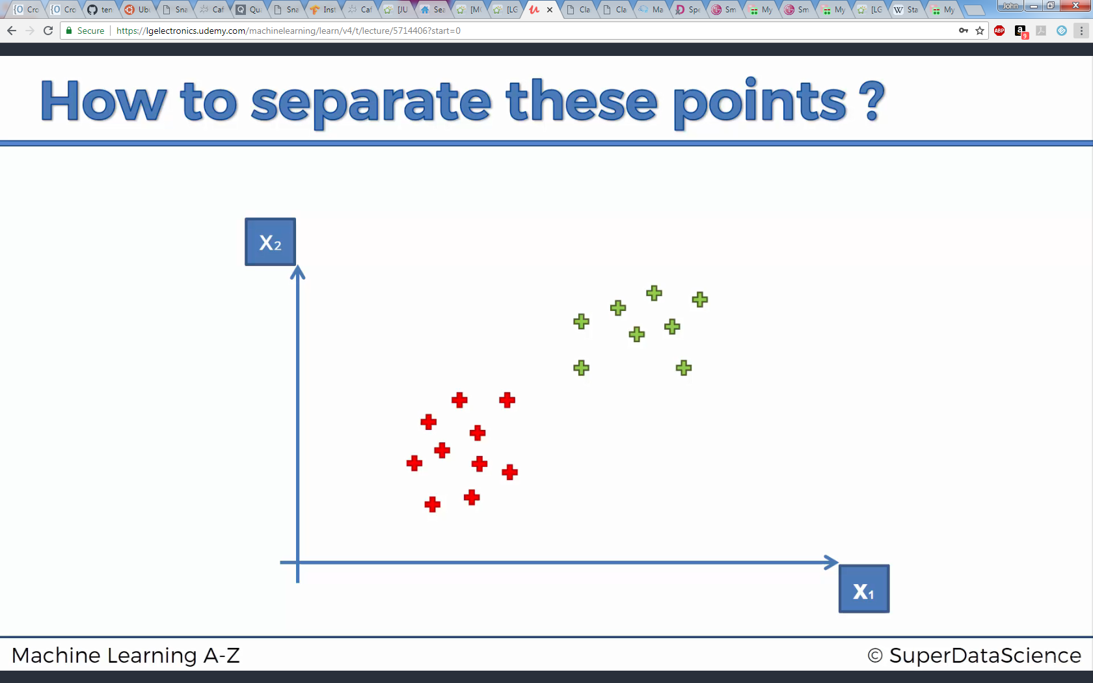
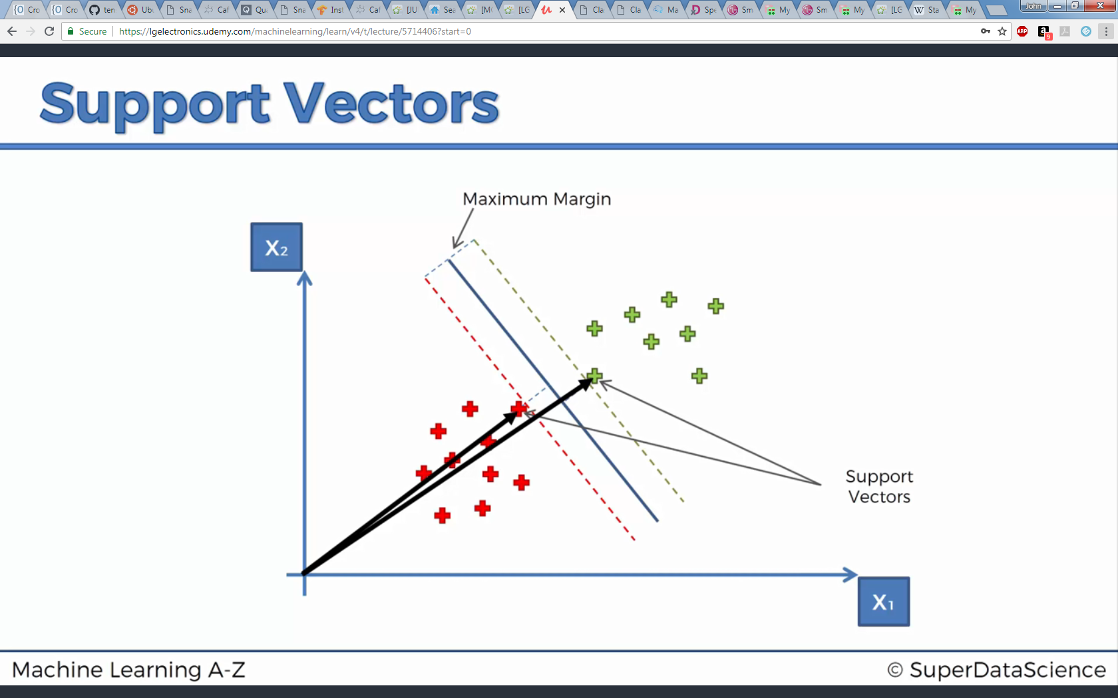
Support Vector Machine (SVM)
Separate categories with linear line

Slide 12
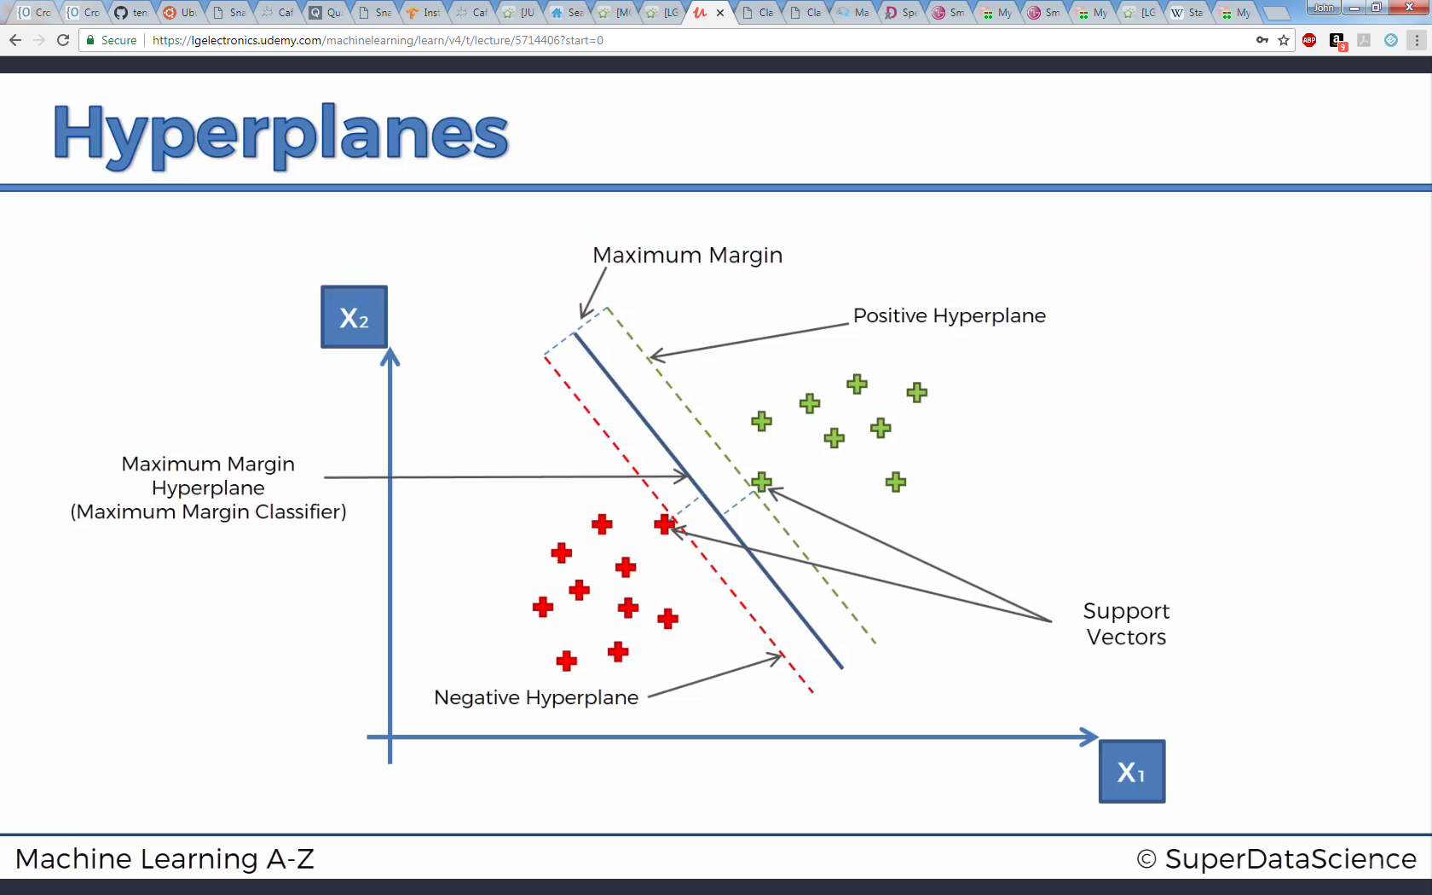
Support Vector Machine (SVM)

Slide 13
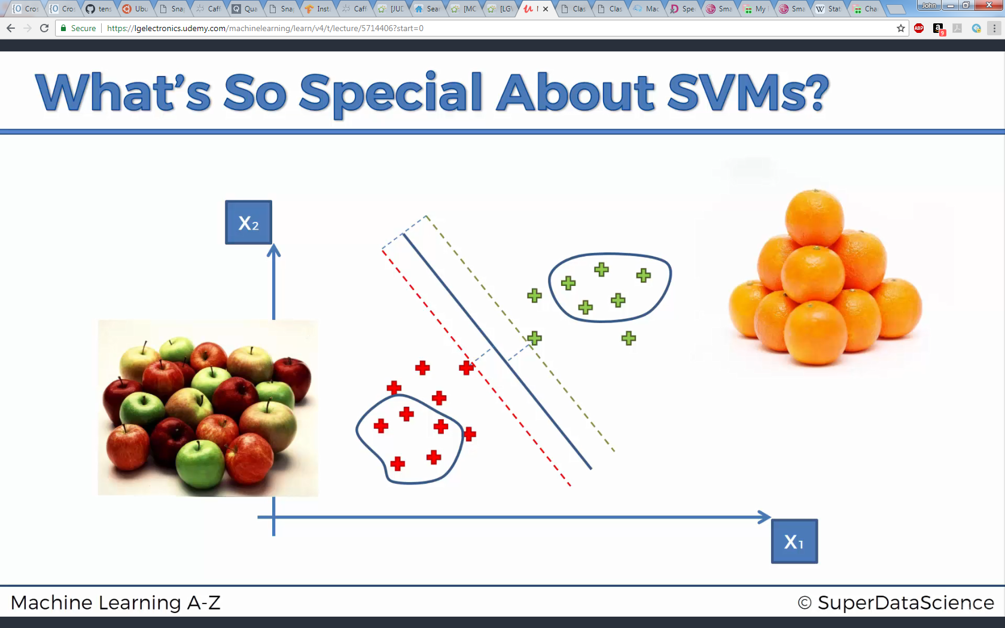
Support Vector Machine (SVM)

Slide 14
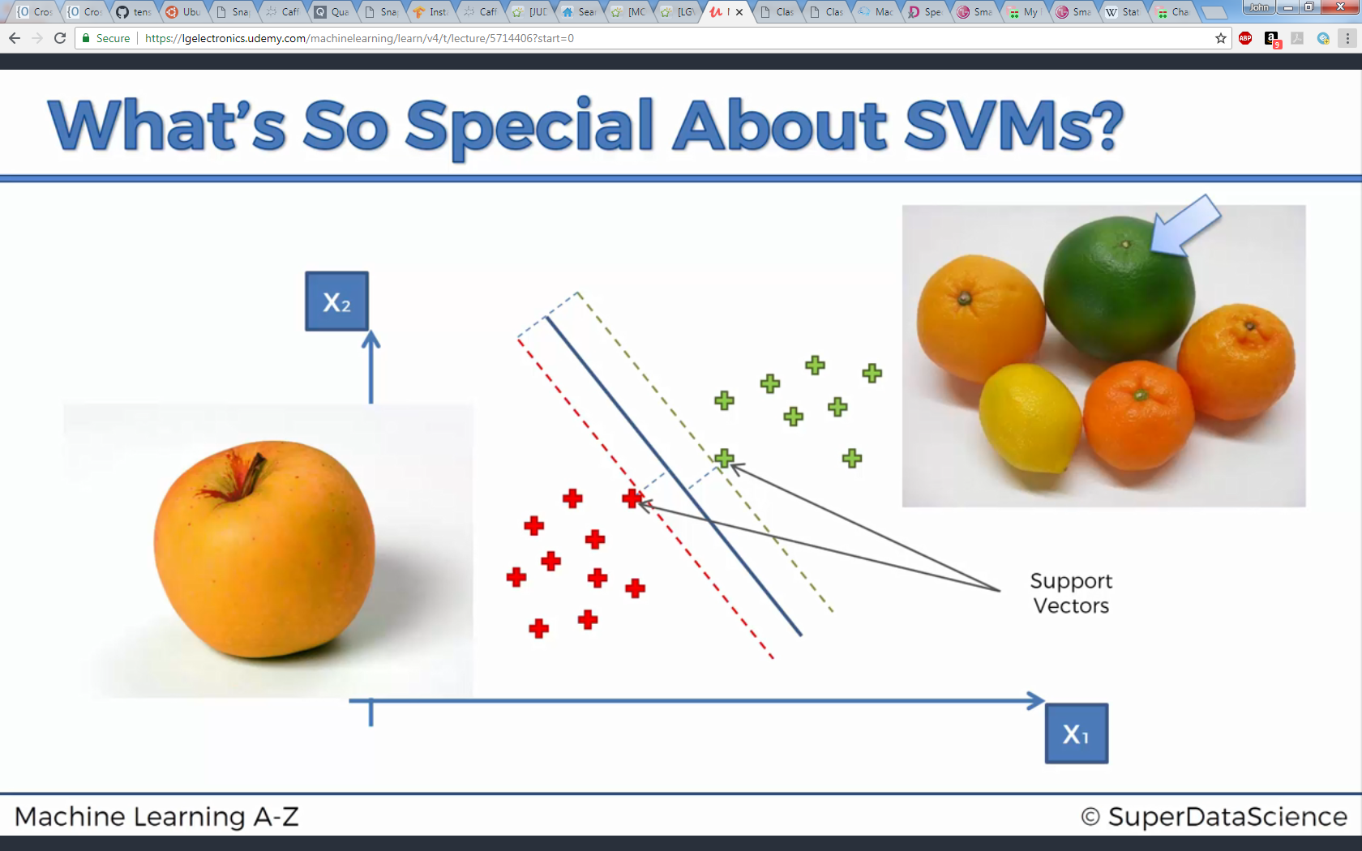
Support Vector Machine (SVM)

Slide 16
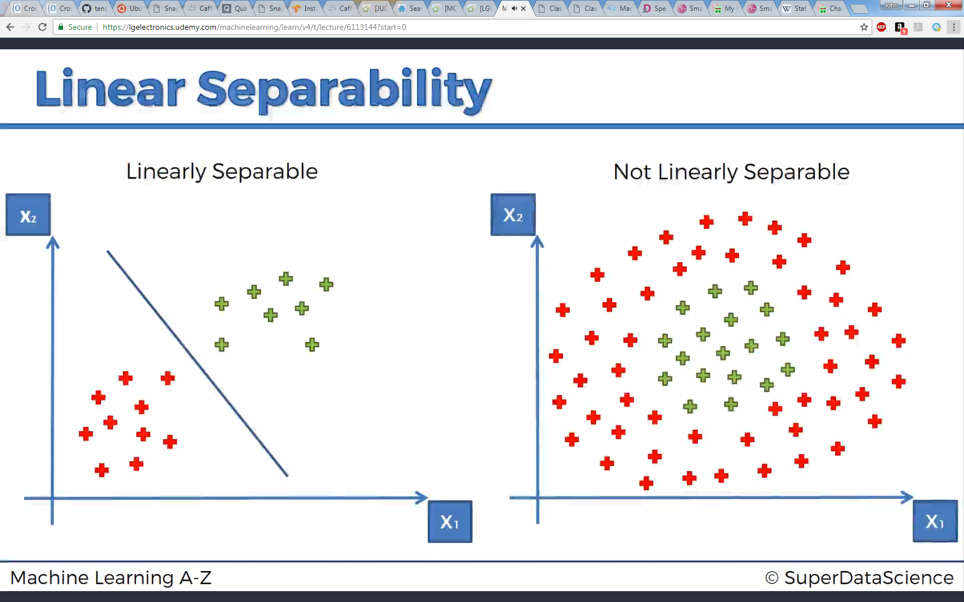
Kernel SVM
Categorizing data that aren’t linearly separable

Slide 17
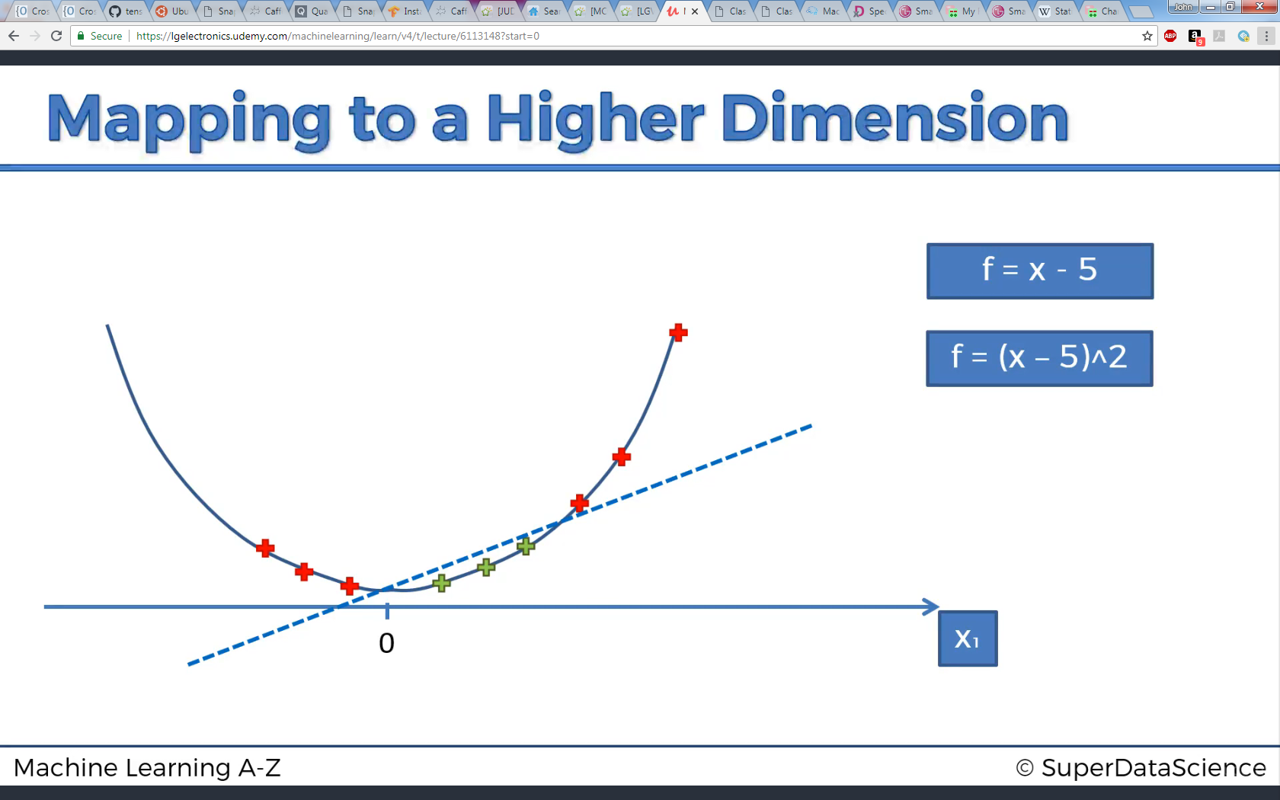
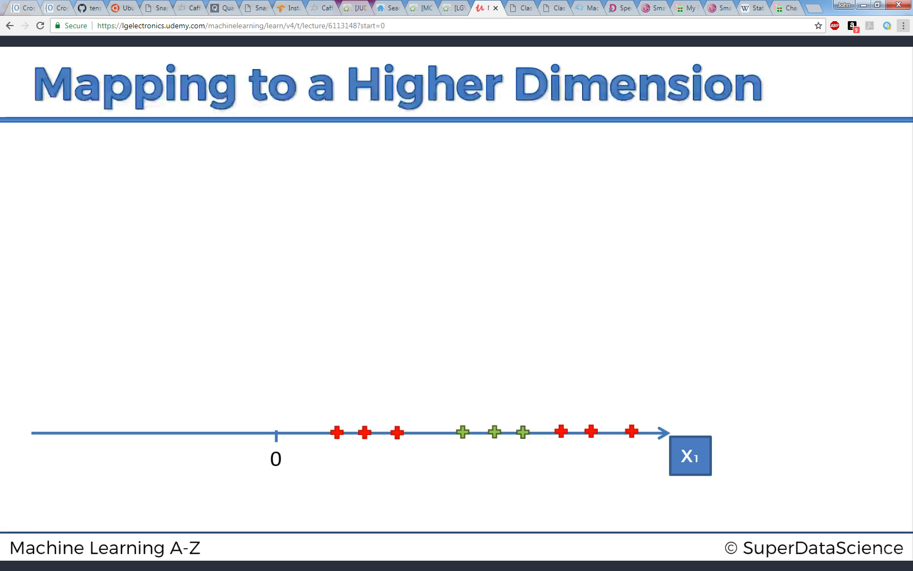
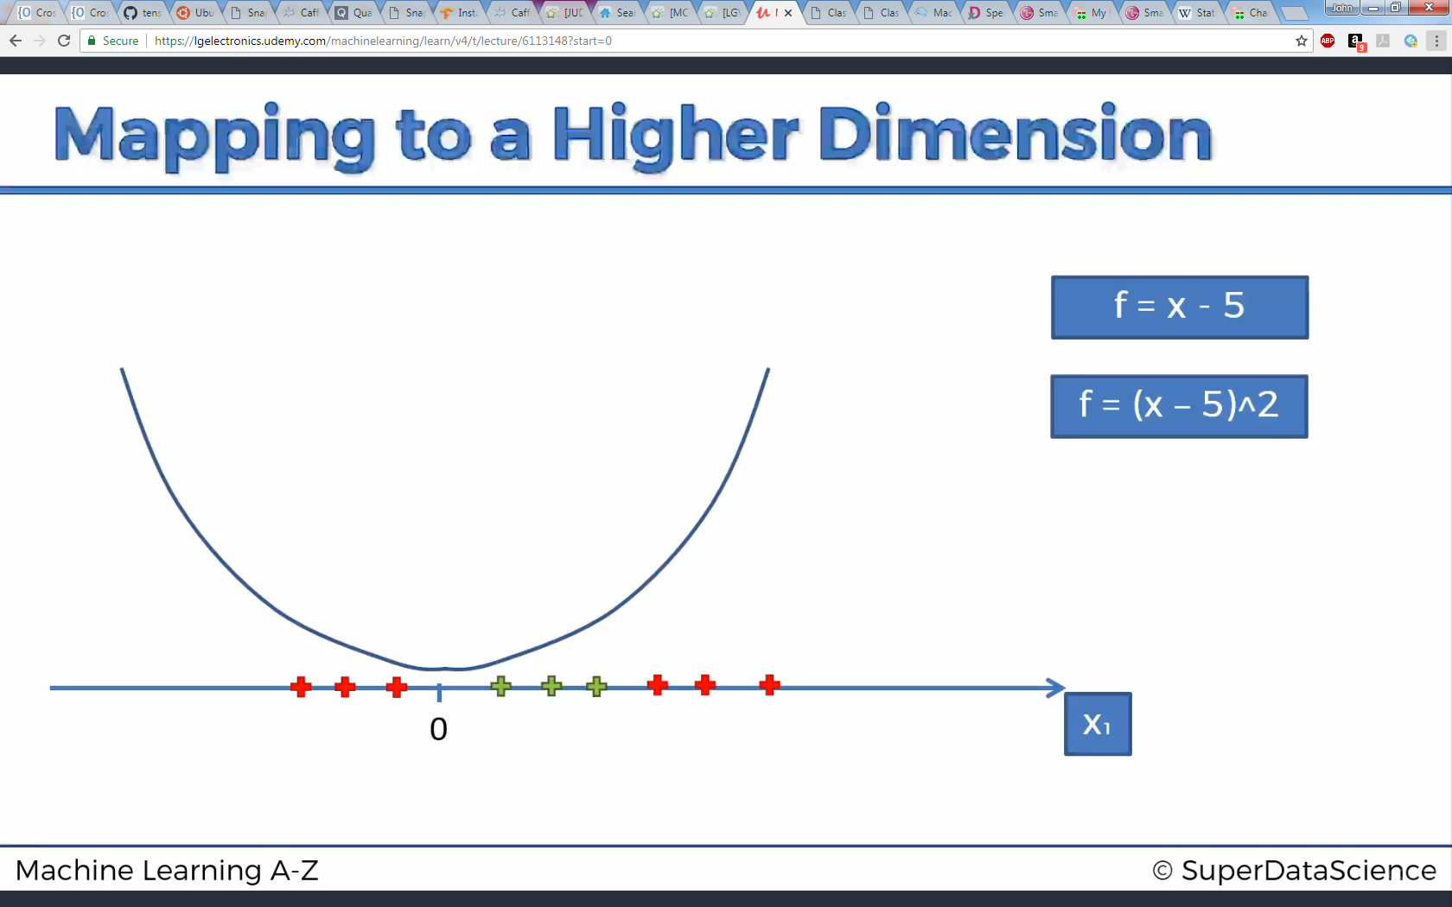
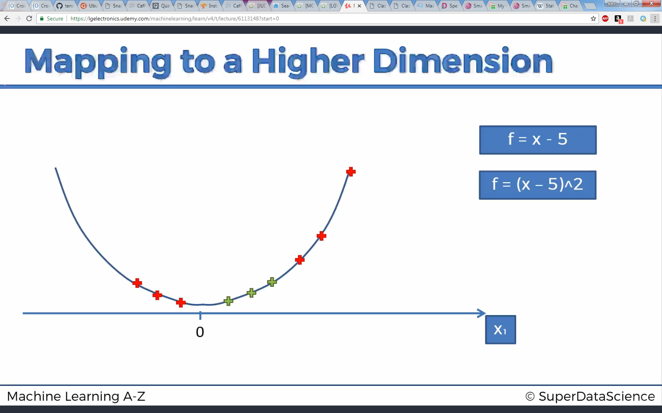
Kernel SVM
1-D to 2-D mapping example

Slide 18
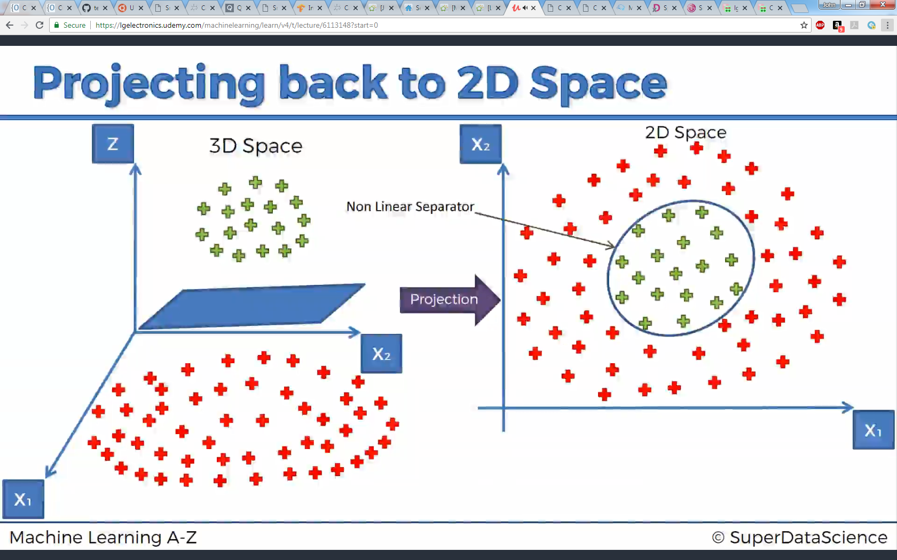
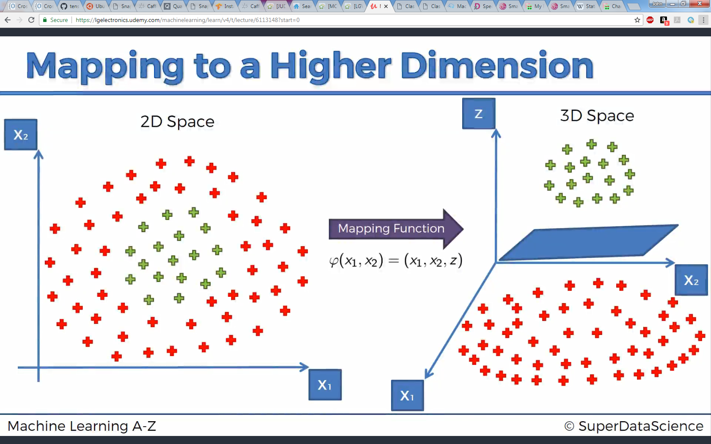
Kernel SVM
2D to 3D …

Slide 19
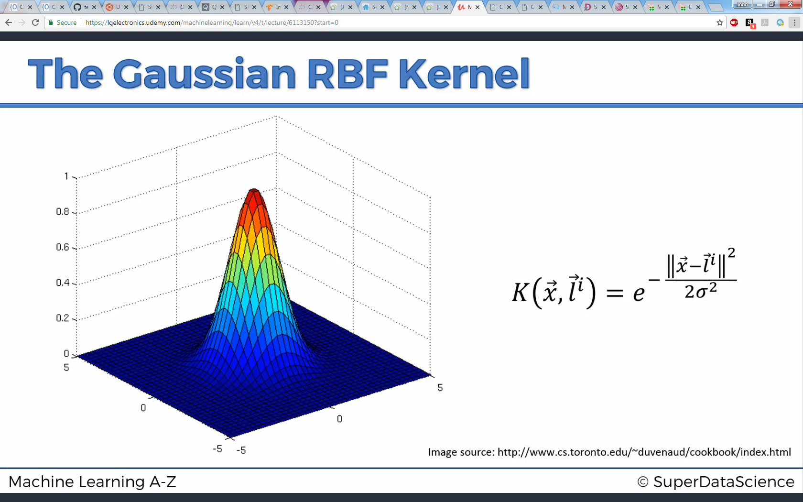
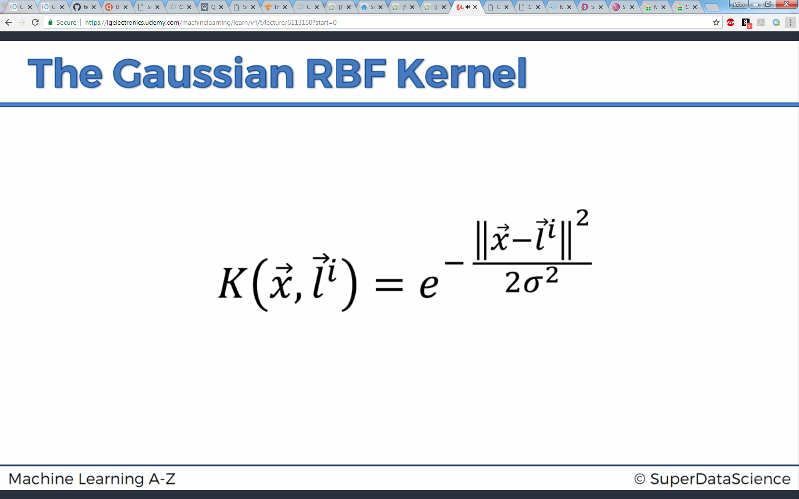
Kernel SVM
Kernel function

Slide 20
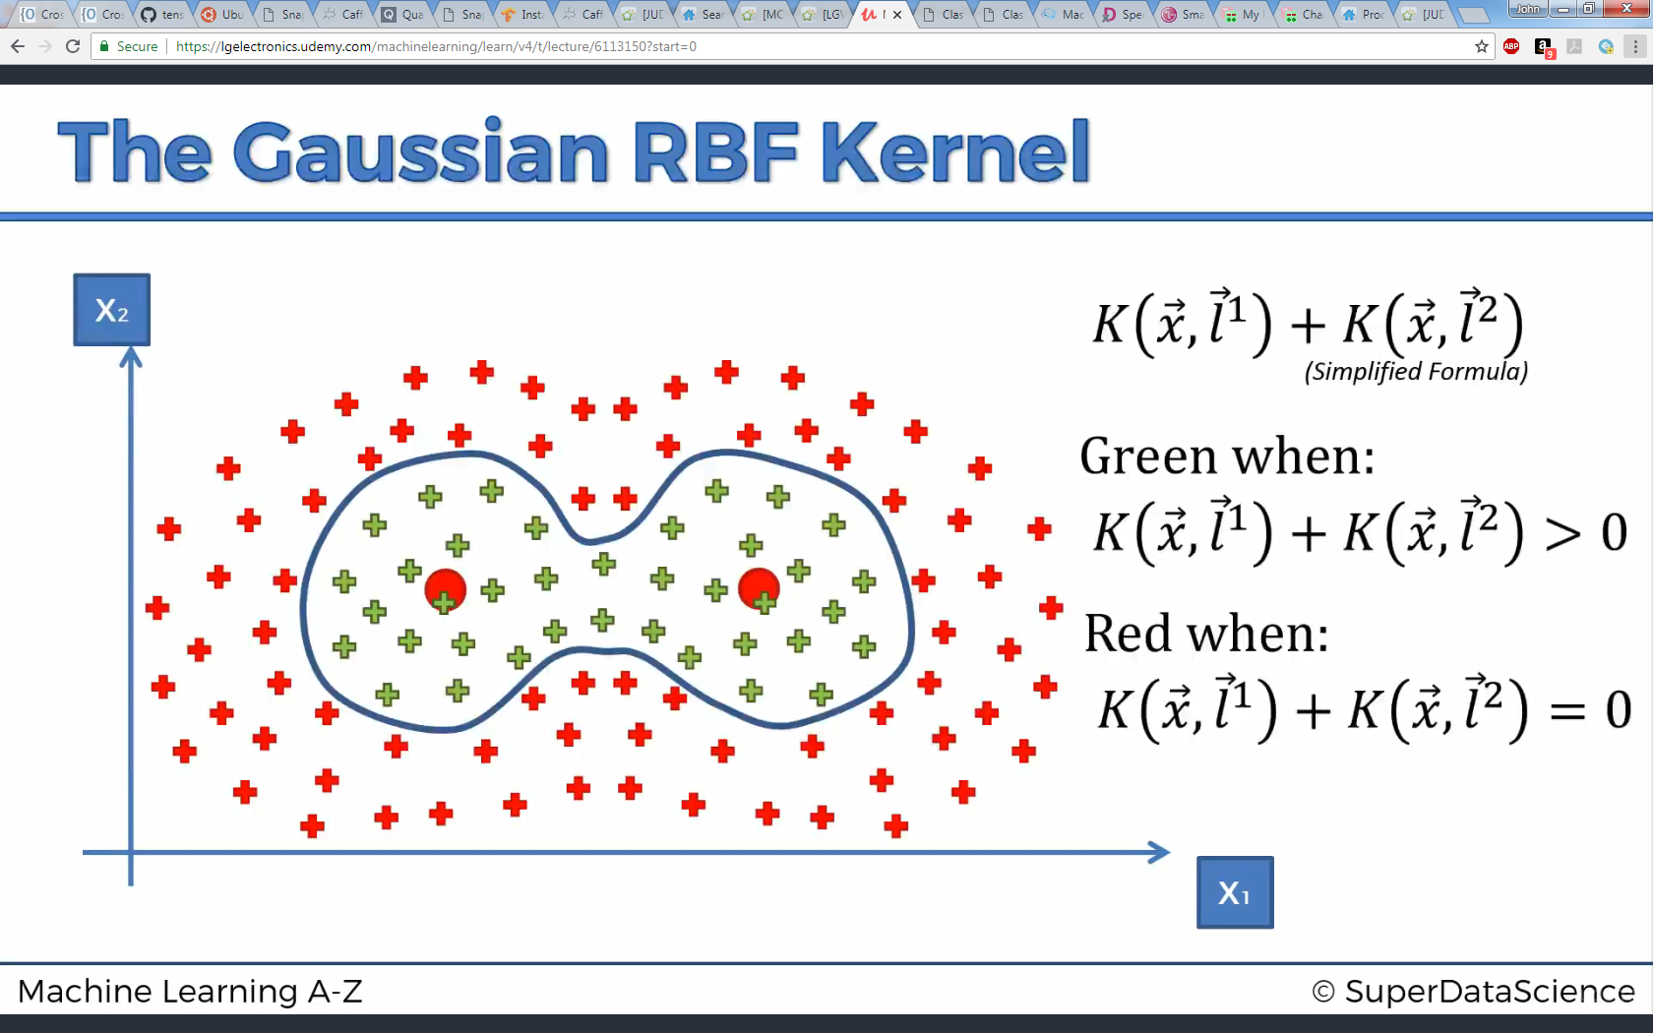
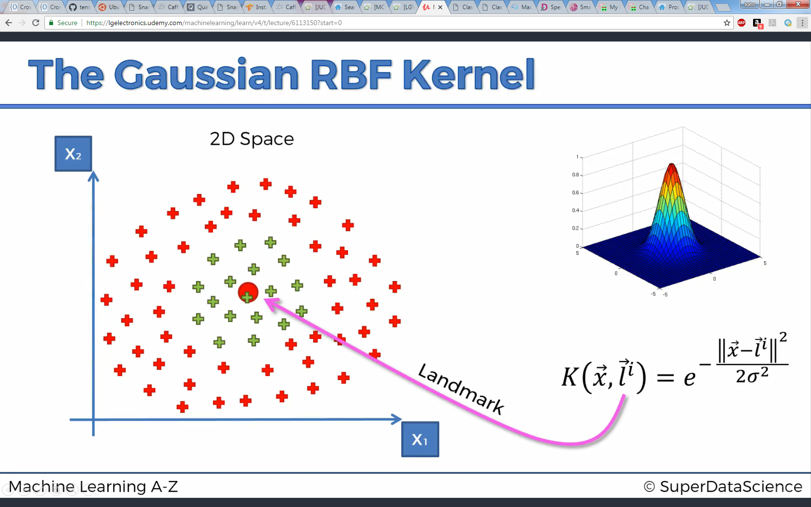
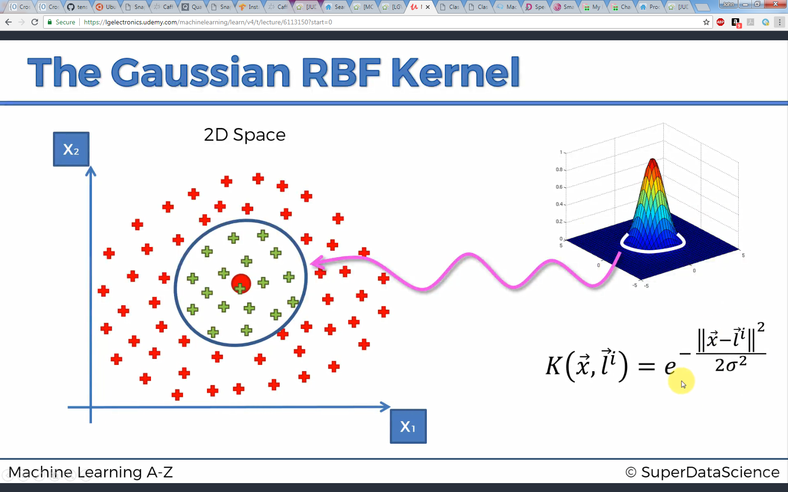
Kernel SVM

Slide 22
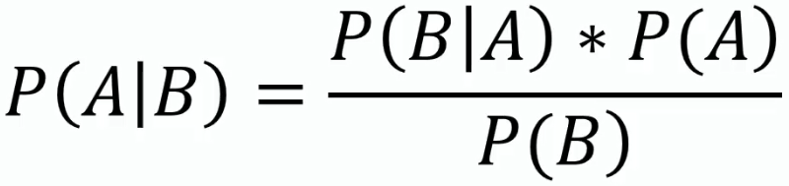
Naïve Bayes
Classification method based on Bayes Theorem of probability:
Likelihood
Prior Probabilty
Posterior Probabilty
Marginal Likelihood

Slide 23
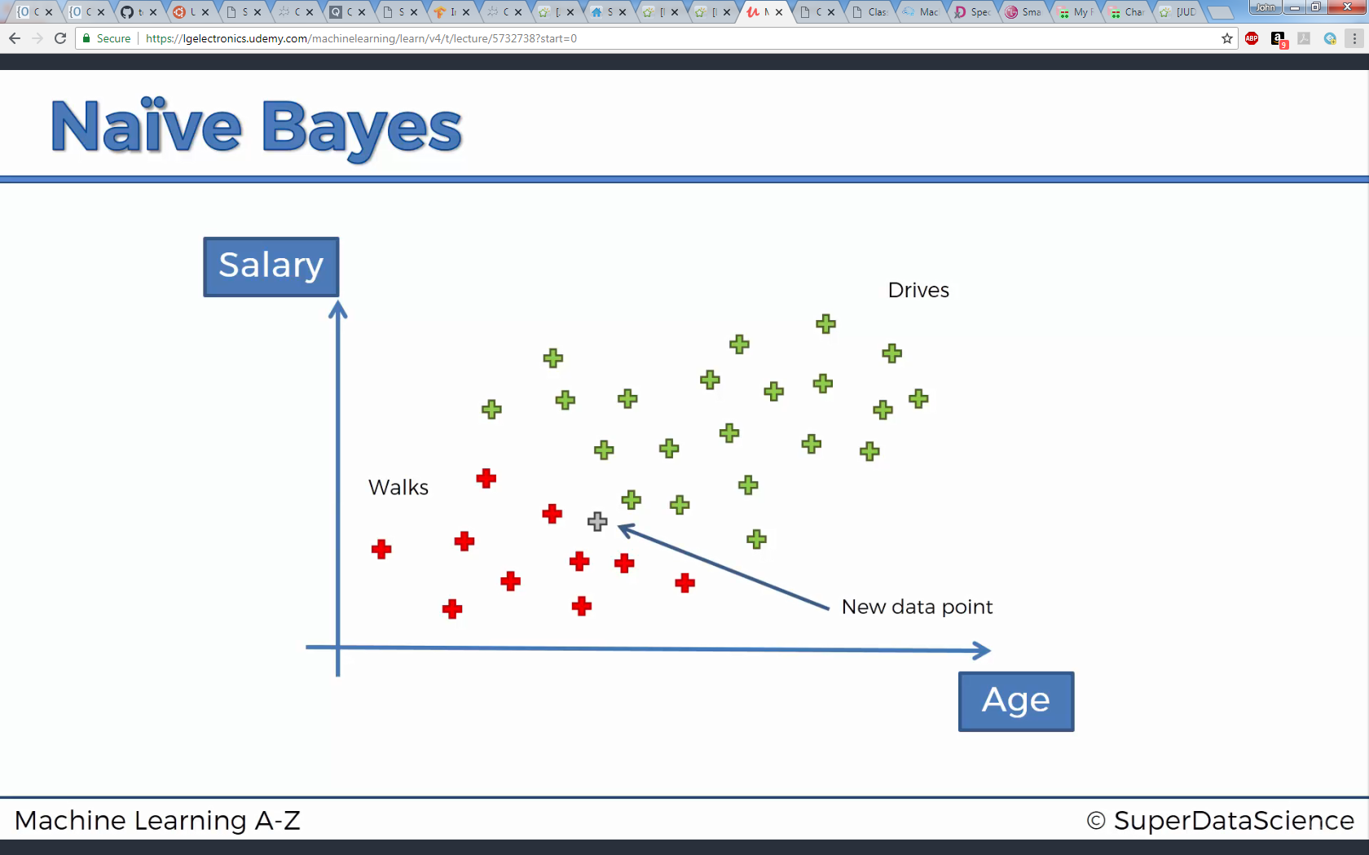

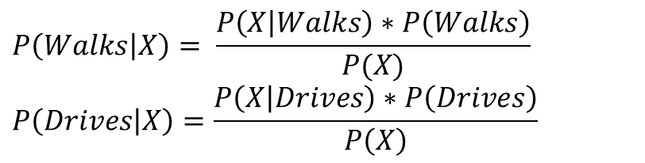
Naïve Bayes
Find and compare P(Walks|X) and P(Drives|X) – categorize to whichever returns higher probabilty
$$P\left(Walks | X\right)= \frac{P\left(X | Walks\right)∗P\left(Walks\right)}{P(X)}$$
$$P\left(Drives | X\right)=\frac{P\left(X | Drives\right)∗P\left(Drives\right)}{P\left(X\right)}$$

Slide 24
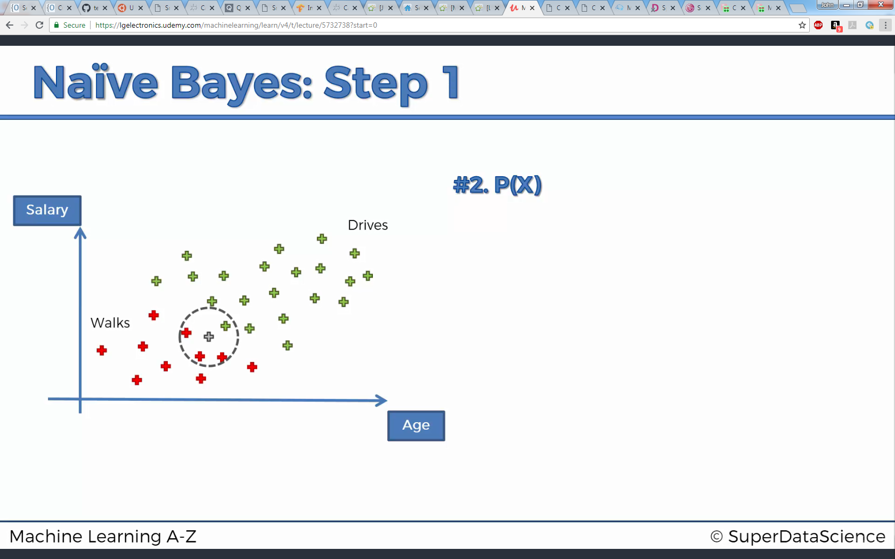
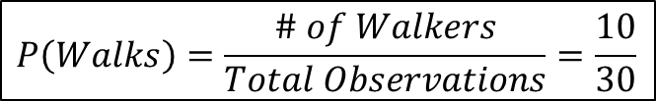
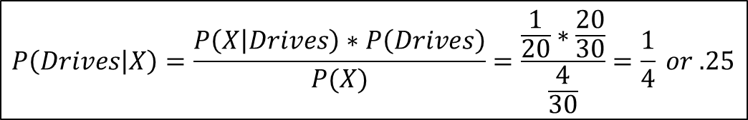
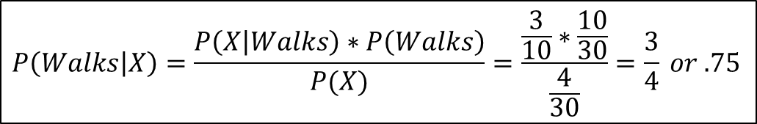
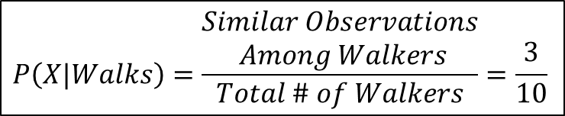
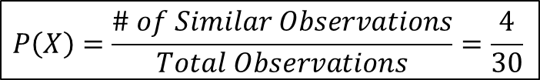
Naïve Bayes
$$P\left(Walks\right)=\frac{\# of Walkers}{Total Observations}=\frac{10}{30}$$
$$P\left(X\right)=\frac{\# of Similar Observations}{Total Observations}=\frac{4}{30}$$
$$P\left(X|Walks\right)=\frac{\begin{aligned}Similar Observations \\ Among Walkers\end{aligned}}{Total \# of Walkers}=\frac{3}{10}$$
$$P\left(Walks | X\right)=\frac{P\left(X | Walks\right)∗P\left(Walks\right)}{P(X)}=\frac{\frac{3}{10}∗\frac{10}{30}}{\frac{4}{30}}=\frac{3}{4} or .75$$
$$P\left(Drives | X\right)=\frac{P\left(X | Drives\right)∗P\left(Drives\right)}{P(X)}=\frac{\frac{1}{20}∗\frac{20}{30}}{\frac{4}{30}}=\frac{1}{4} or .25$$

Slide 29
which model to choose
Figure out whether the problem is linear or non linear
If the problem is linear, use Logistic Regression or SVM
If the problem is non linear, use K-NN, Naive Bayes, Decision Tree or Random Forest

Slide 30
which model to choose
Use Logistic Regression or Naive Bayes when you want to rank your predictions by their probability - rank your customers from the highest probability that they buy a certain product, to the lowest probability
Use SVM when you want to predict to which segment your customers belong to

Slide 31
which model to choose
Decision Tree when you want to have clear interpretation of your model results
Random Forest when you are just looking for high performance with less need for interpretation

